Slide 1
Graphic Design Elements and principles
Introduction to Game Design Studio

Slide 2
Im not an artist.
Why should I learn about graphic design?
Even game programmers need to learn about graphic design.
When working on a game, there must be collaboration in all team roles to achieve a unified finished product
Artists often rely on programmers to have their creations come to life
For some smaller companies and indie developers, more responsibility falls on programmers to create some basic design elements such as menus, animations etc.

Slide 3
Roles in Games that use graphic design
Animator
Background Artist / Modeler
Concept Artist
Texture Artist
Creative Directors/Lead Deesigners
Level Designers
Technical Artist
Marketing
Motion Designer
Programmer
Combat Designer
etc.

Slide 4
Principles and Elements of Design
The Principles and Elements of Design remain universal to all fields of art. They are the guiding backbone to creating pleasing visuals.
Principles of Design - are concepts used to organize or arrange the structural elements of design. The way in which these principles are applied affects the expressive content, or the message of the work.
Elements of Design - The elements of design can be thought of as the things that make up a painting, drawing, design etc. Good or bad - all paintings will contain most of if not all, of the seven elements of design.

Slide 5
The Principles of Design
BALANCE - Balance in design is similar to balance in physics. A large shape close to the center can be balanced by a small shape close to the edge. Balance provides stability and structure to a design. It’s the weight distributed in the design by the placement of your elements.
PROXIMITY - Proximity creates relationship between elements. It provides a focal point. Proximity doesn’t mean that elements have to be placed together, it means they should be visually connected in someway.
ALIGNMENT - Allows us to create order and organization. Aligning elements allows them to create a visual connection with each other.
REPETITION - Repetition strengthens a design by tying together individual elements. It helps to create association and consistency. Repetition can create rhythm (a feeling of organized movement).
CONTRAST - Contrast is the juxtaposition of opposing elements (opposite colours on the colour wheel, or value light / dark, or direction - horizontal / vertical). Contrast allows us to emphasize or highlight key elements in your design.
SPACE - Space in art refers to the distance or area between, around, above, below, or within elements. Both positive and negative space are important factors to be considered in every design.

Slide 6
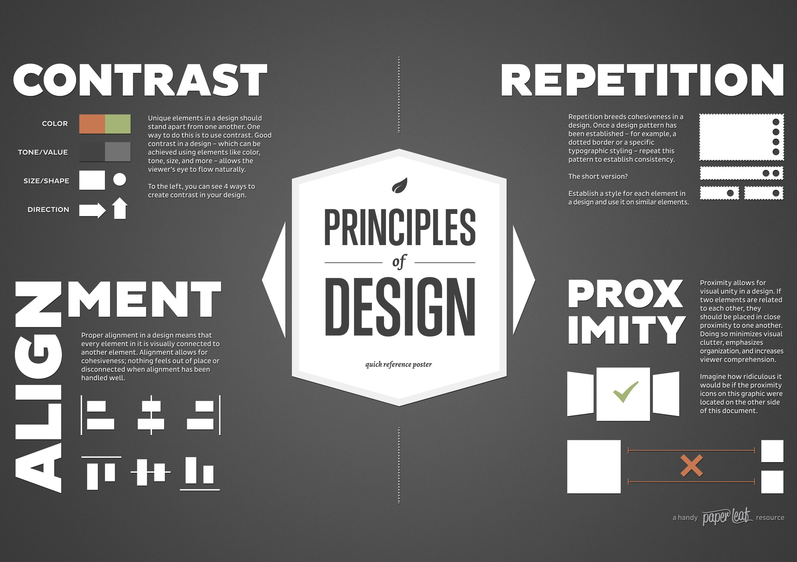
The Principles thought of most in Graphic Design

Slide 7
Elements of Design
LINE - Line can be considered in two ways. The linear marks made with a pen or brush or the edge created when two shapes meet.
SHAPE - A shape is a self contained defined area of geometric or organic form. A positive shape in a design automatically creates a negative shape.
DIRECTION - All lines have direction - Horizontal, Vertical or Oblique. Horizontal suggests calmness, stability and tranquillity. Vertical gives a feeling of balance, formality and alertness. Oblique suggests movement and action
SIZE - Size is simply the relationship of the area occupied by one shape to that of another.
TEXTURE - Texture is the surface quality of a shape - rough, smooth, soft hard glossy etc. Texture can be physical (tactile) or visual.
COLOR - Also called Hue
VALUE - Value is the lightness or darkness of a colour. Value is also called Tone

Slide 8
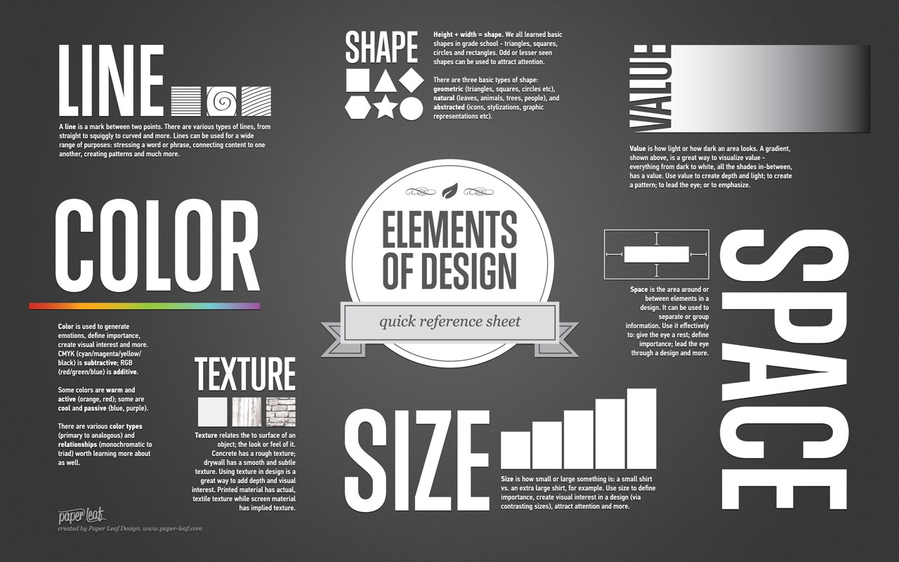

Slide 9
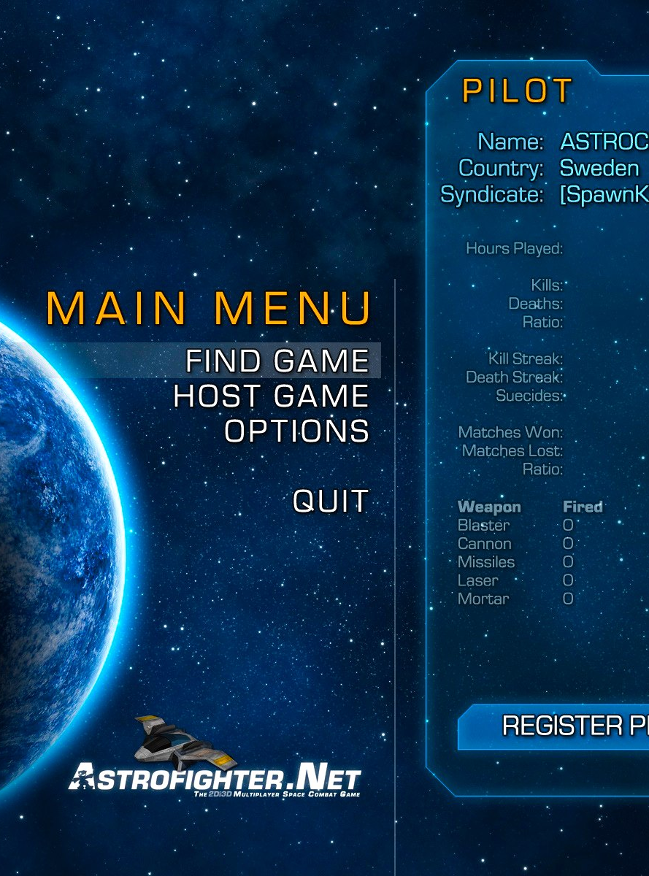
Graphic Design is traditionally defined as problem solving on a flat, two-dimensional surface.
-Multimedia design expands the field into 3-D and time-based 4-D applications
-Problems in Graphic Design relate to visual communication.
-Graphic Designers will often join with other artists or create art themselves for their work
-A designer is not in search of one solution, but several. There is no one correct answer in Graphic Design
Astrofighter Main Menu
http://blog.imphenzia.com/2011/09/28/menu-flow-of-astrofighter-net/

Slide 10
THe information age
Graphic Designers can be thought of as Information Architects
-The organization of information is a vital part of all Graphic Design
A graphic designer must find ways to get across vital information to the viewer by prioritizing and organizing the important details of the image and text
As game designers this must be in the back of your mind at all times.

Slide 11
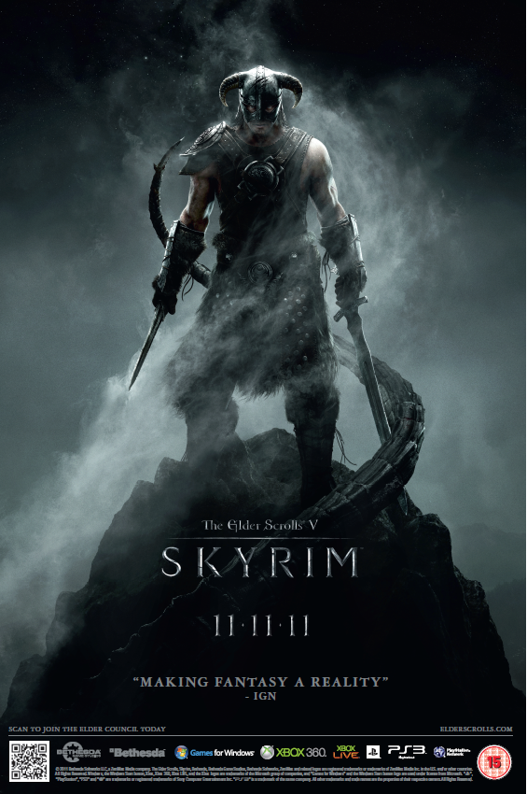
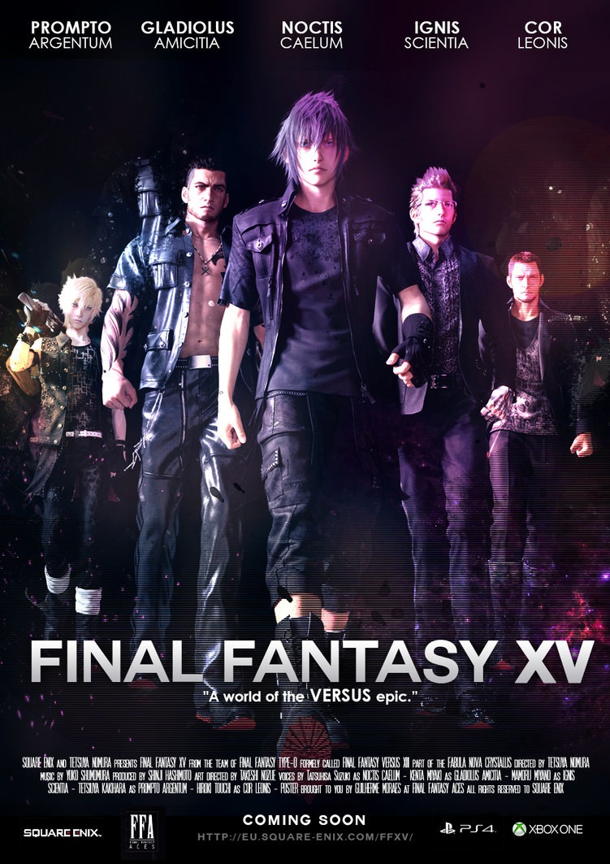
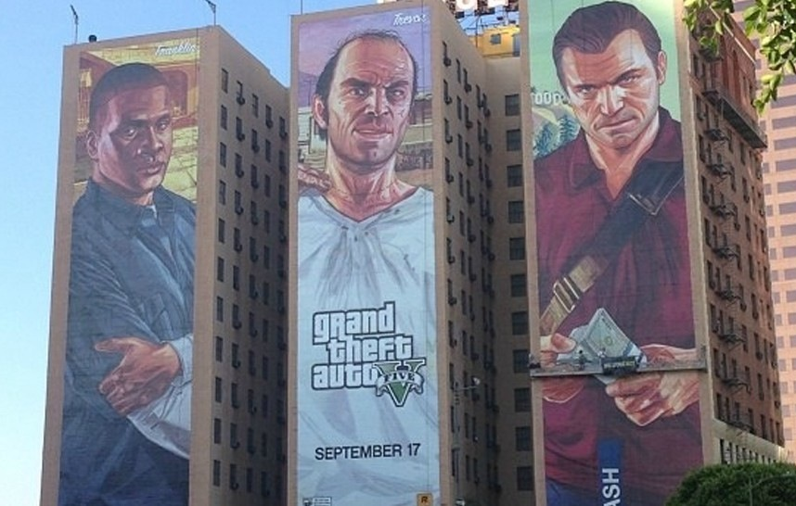

Slide 12
The design process
Step 1: Research - determine the parameters of the problem, study related materials
Step 2: Thumbnails - small idea sketches that provide visual evidence of the thinking, searching, and sorting process that leads to the final solution.
Usually quick sketches by hand
Step 3: Roughs - best thumbnails are refined and polished.
Typically done on computer, to give polished complete look. Often given to clients or creative leads for feedback.
Step 4: Comprehensive - The final piece of art as edited through the previous steps. A Graphic Designer would have colleagues evaluate and critique before sending this to the client for final approval.
If creating a scene or menu for a game, this would be presented as a storyboard

Slide 13
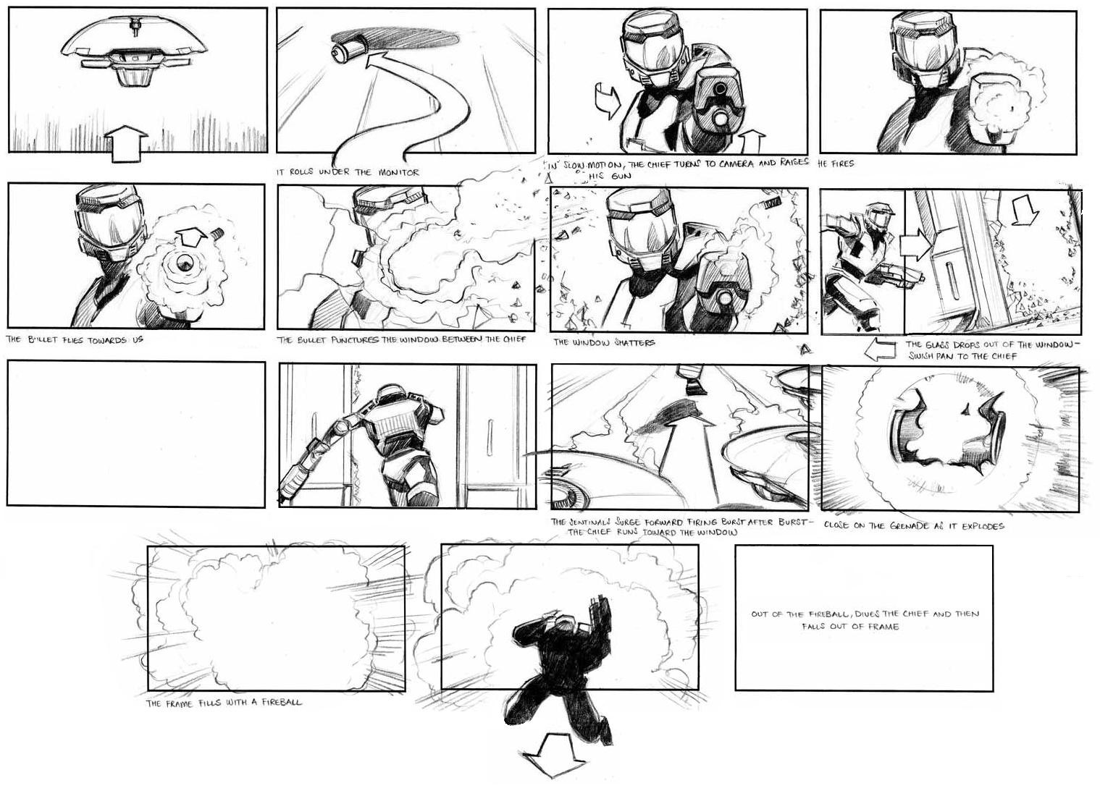
Thumbnails - Halo

Slide 14
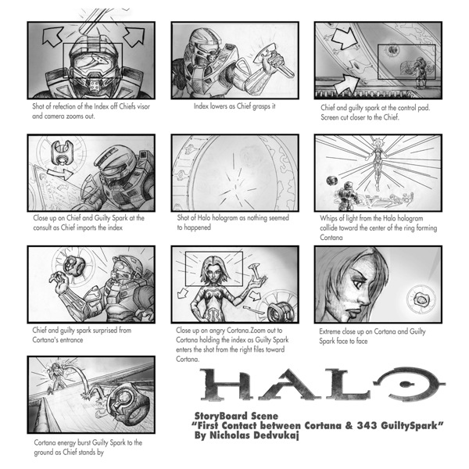
Storyboard Scene - Halo

Slide 15
Interactive Design
As Game Designers, much of your Graphic Design focus will fall under Interactive Design
Interactive Design focuses on usability for the end user. The goal is to strive for the least obstructive and most intuitive interaction with the information while maintaining good visual appeal
Think of examples of bad and good interactive design you have seen in games. What was made them successful or unsuccessful?

Slide 16
designing for games
Color/Hue :
Do not just rely on color to communicate. Members of your gaming audience may have color blindness or difficulty differentiating between colors. Adding shapes, textures, etc. help add to your message. (Consider Bejewled)
Pick a color scheme that represents your game. Using a set color scheme will help create cohesion and unity
Balance bright colors with neutrals to create color harmony
Do not keep your game colors monochromatic or dull. Unless this is a vital component of your game story, it will become flat and disengaging to the user. Additionally it can be hard to see.

Slide 17
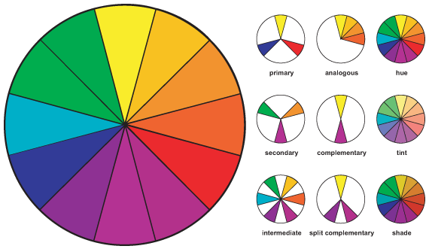
designing for games
The color wheel
can be used when
seeking
complimentary
colors.
If you have trouble
with color aesthetics
Tips can be found
here: Color Wheel Tips

Slide 18
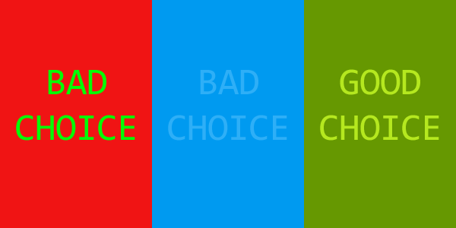
designing for games

Slide 19

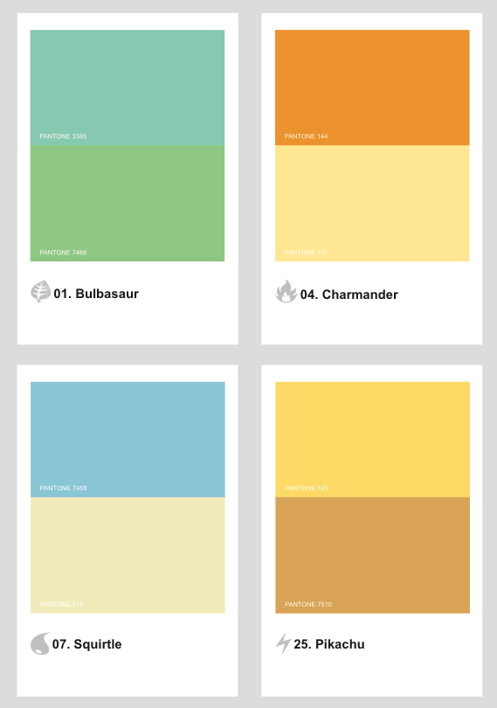
Pokemon characters represented by their color schemes

Slide 20
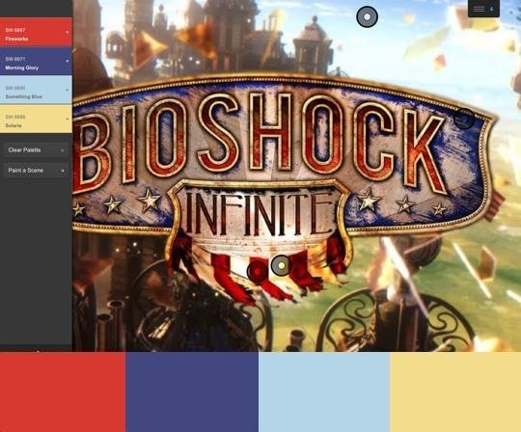
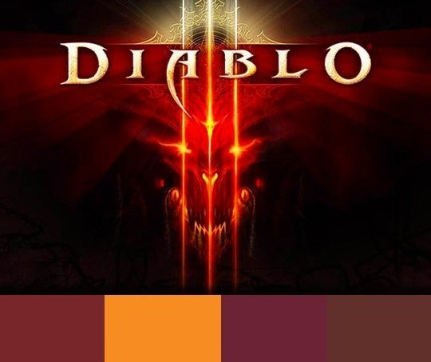
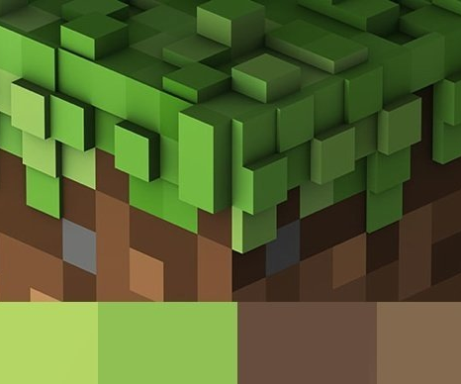
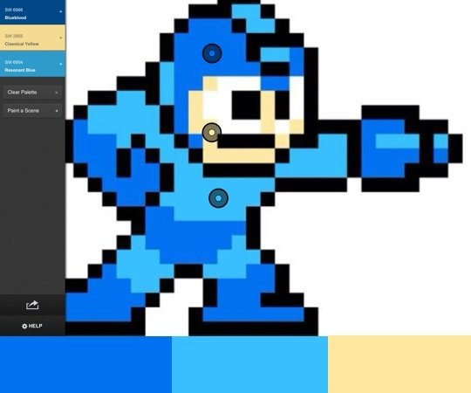

Slide 21

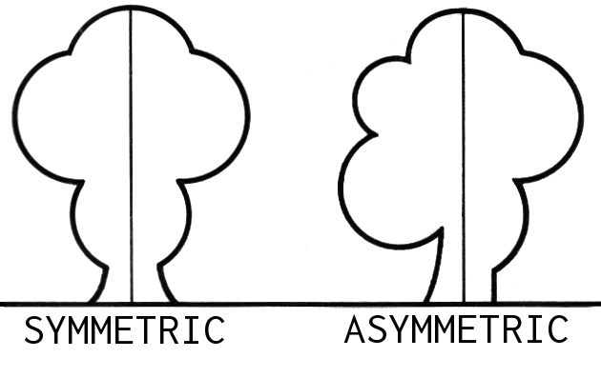
designing for games
Balance:
Balance is what gives a design stability and equilibrium. It distributes visual “weight” throughout space making the design seem fluid rather than lopsided or heavy. Giving objects or scenes balance helps fill the space and gives the players eyes an ease to look around without subconsciously trying to fill the emptiness.
Asymmetrical balance can create tension, movement, and a different atmosphere by throwing out the balance scale. If used effectively, this can be a great way to draw attention to a design.

Slide 22


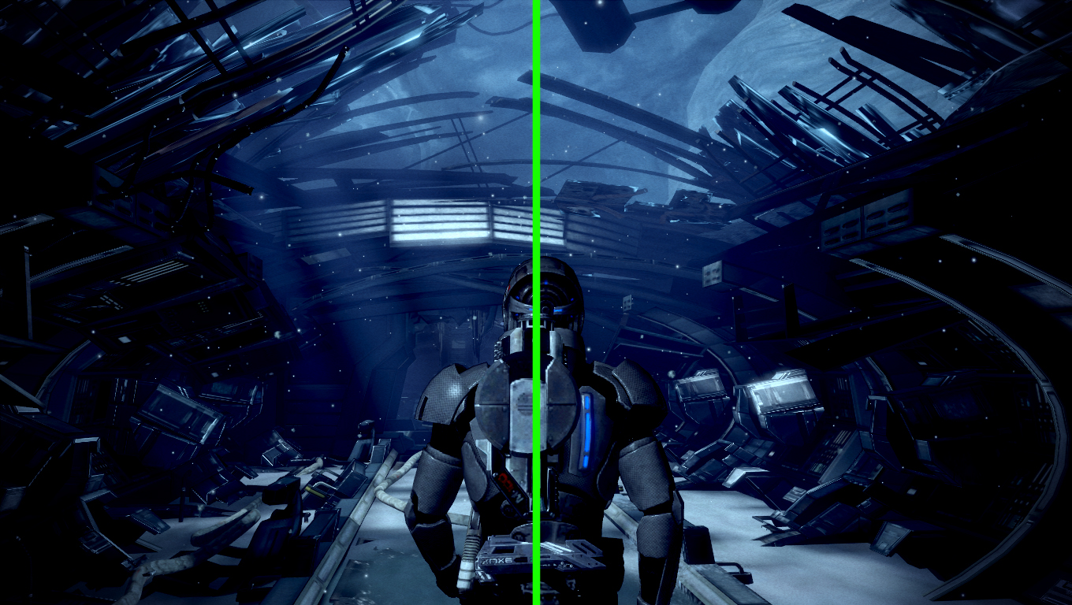
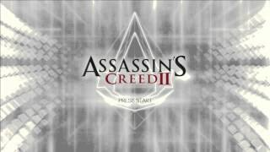

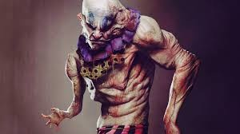

Slide 23

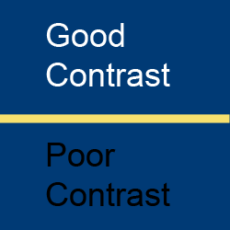
designing for games
Contrast :
Make sure you use enough contrast in your graphics to keep objects and text visible to all users. This can be completed through differing color, lighting, or textures.

Slide 24
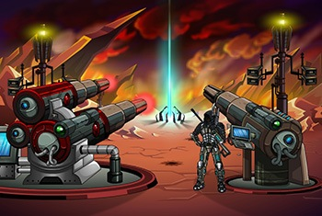
designing for games
Alignment:
To keep a polished and cohesive feel, keep components aligned when necessary. When done properly nothing feels out of place or disjointed.
Alignment can also be used to give a player a glimpse at what we would like them to do without giving text instructions.

Slide 25
designing for games
Art:
Keep your game art cohesive. Often when pulling art from many different sources the game can begin to fill disjointed and poorly designed.
Keep the art to your vision of the game.
Set the tone of your game starting with your menu. When a game asks us to “Press Start", we get a glimpse of its aesthetics.

Slide 26
Helpful Links
Key Graphic Design Principles
Lighting Tips
Color Scheme Creator
Books in the UNCC Library:
Whats Graphic Design For? -Alice Twemlow
Game Art - The Graphic Art of Computer Games - Dave Morris and Leo Hartas
Graphic Design Reference - Byrony Gomez - Palacio and Armin Vit
Graphic Design Basics - Amy E. Arntson

